Slide 1
Regions Reconstructing the UI
Bob Brumfield
Microsoft SDE

Slide 2
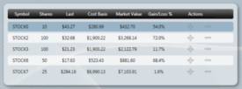
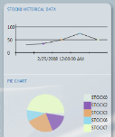
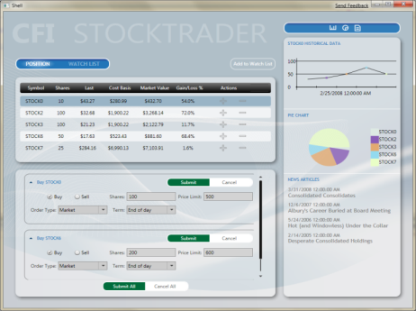
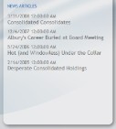
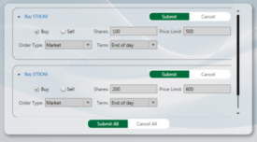
(Re)Constructing the UI
Shell – Application Host Window
Regions – Named Areas For View Placement
Views – Module UI & Presentation Logic
Region
Region
Region

Slide 3
View Injection
Uses Code to Add Views to a Region
Prism Navigation API uses View Injection
<ItemsControl RegionManager.RegionName= “DataRegion">
MyView view = …;
IRegion buySellRegion = regionManager.Regions[ “BuySellRegion" ];
buySellRegion.Add( view );
<ContentControl RegionManager.RegionName = “BuySellRegion” />
Region
Region
Region

Slide 4

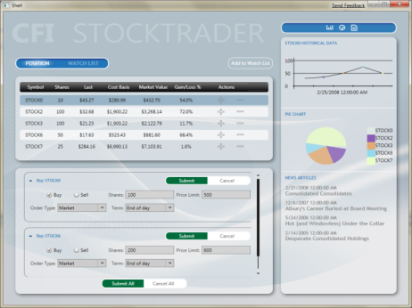

View Discovery
Automatically Shows Views, Less Complex
Black Box ‘App Assembly’ Composition
Registered Views Pulled into Region
Register in code or use attribute
regionManager.RegisterViewType(
“BuySellRegion", typeof( BuySellView ) );
<ContentControl RegionManager.RegionName = “BuySellRegion” />
Region
Region
Region

Slide 5
demo

Slide 6
Controls and Region
RegionAdapter
Control
RegionManager
Behaviors
Region
Behaviors
Region
Region Behaviors
Region
View
View
View

Slide 7
Active Awareness
Tab Control
Content Control
Items Control
Single Active Region
All Active Region

Slide 8
demo

Slide 9
Passing Context
Customer A
Customer B
Customer C
Customer List
RegionManager.RegionContext
={Binding
ElementName=CustomerList,
Path=SelectedItem}
Tab Control (InfoRegion)
Details View
RegionContext
.GetObservableContext(this)
.Value

Slide 10
demo

Slide 11
Adding Region Behaviors
Control
RegionAdapter
RegionManager
Delayed Region Creation
Behavior
Region
Region
Region
AutoPopulate
Behavior
RegionActiveAware Behavior
View
View
View
SyncRegionContextWithHost
Behavior

Slide 12
Demo
Adding a region behavior

Slide 13
Scoped Regions
ContentRegion
Customer View
(Customer A)
Customer View
(Customer B)
ItemDetailsRegion
ItemDetailsRegion
Details View

Slide 14
Q/A

